Slide 1



Book Worm: Unleashing the Power of AI on Book Recommendation
Maryam Nozari, PhD
May 2023
Notes:
My motivation for this project stems from my own struggles in finding books to read. As an avid reader and book enthusiast who enjoys exploring various genres, I have often found myself investing significant time in perusing Amazon reviews, seeking out bestsellers, and consulting friends on forums for their recommended reads. Despite following this meticulous process, there have been instances where I ended up reading books that didn't resonate with me. Consequently, I am eager to develop a more efficient method of selecting books, enabling me to dive into captivating reads without dedicating more time to the selection process than to the act of reading itself.

Slide 2

Data Science Method
Problem Identification
Data Wrangling
Exploratory Data Analysis
Pre-Processing and Training Data Development
Modeling
Documentation
Notes:
Problem Identification
Identify the Problem
Data Wrangling
Collect, organize, define, and clean the dataset
Exploratory Data Analysis
Understand the relationship between data and features
Pre-Processing
Standardize and train the dataset
Modeling
Select train and deploy a model to make predictive insight
Documentation
Document and share findings

Slide 3

With millions of books available on the Goodreads platform, it is overwhelming for users to find books that match their preferences.
Problem Identification
Data Wrangling
Exploratory Data Analysis
Pre-Processing and Data Development
Modeling
Documentation
Problem

Slide 4
Problem Identification
Data Wrangling
Exploratory Data Analysis
Pre-Processing and Data Development
Modeling
Documentation
Goal
This project aims to build a book recommendation system for Goodreads users, which suggests books based on their reading history, preferences, and ratings.

Slide 5



Problem Identification
Data Wrangling
Exploratory Data Analysis
Pre-Processing and Data Development
Modeling
Documentation
Data Acquisition
UCSD Book Graph
Meta-data of the books
User-book interactions
Users' detailed book reviews

Slide 6
Problem Identification
Data Wrangling
Exploratory Data Analysis
Pre-Processing and Data Development
Modeling
Documentation
Data Acquisition
UCSD Book Graph
Meta-data of the books
goodreads_books.json.gz
User book interactions
Users' detailed book reviews
Notes:
Data Extracted from UCSD Goodreads data: https://sites.google.com/eng.ucsd.edu/ucsdbookgraph/home

Slide 7

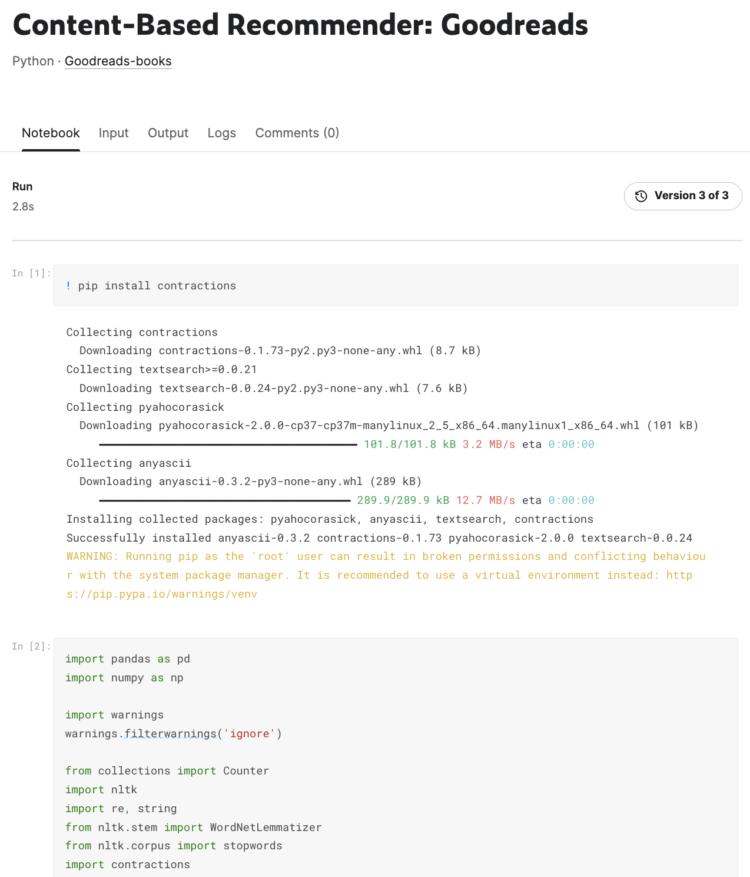
Problem Identification
Data Wrangling
Exploratory Data Analysis
Pre-Processing and Data Development
Modeling
Documentation
Data Organization
UCSD Book Graph
Meta-data of the books
goodreads_books.json.gz
User book interactions
Users' detailed book reviews
Notes:
684.8 MB

Slide 8
Problem Identification
Data Wrangling
Exploratory Data Analysis
Pre-Processing and Data Development
Modeling
Documentation
Data Shape
UCSD Book Graph
Meta-data of the books
goodreads_books.json.gz
User book interactions
Users' detailed book reviews
Kind: JSON
Size: 9.2 GB
Shape: 1115445, 16

Slide 9
Problem Identification
Data Wrangling
Exploratory Data Analysis
Pre-Processing and Data Development
Modeling
Documentation
Data Definitions
Columns | Descriptions
book_id | unique ID for each book
author_id | the id(s) for author(s)
authors | Author(s) names
title | titles of the books
description | short description of each book
publisher | publisher of each book
genres | genres given by the users
avg_ratings | average rating decided by the users
rating_count | number of ratings given
num_pages | number of pages of each book
pub_year | the year the book was published
simillar_books | List of similar books
url | the Goodread link
Notes:
The goal of building data definitions is to describe the features in your dataset with enough detail to:
Identify any issues that will require cleaning
Identify the features of my model
Begin to understand how those features will support the project

Slide 10
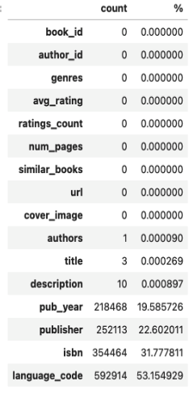
Problem Identification
Data Wrangling
Exploratory Data Analysis
Pre-Processing and Data Development
Modeling
Documentation
Data Quality: Number of Missing Values by column

Slide 11
Problem Identification
Data Wrangling
Exploratory Data Analysis
Pre-Processing and Data Development
Modeling
Documentation
Data Quality: Imputing Missing Values
Create the imputer object with most frequent strategy
Fit the imputer to the data
Impute missing values in each column
Convert the imputed data back to the original data frame
Notes:
From sklearn.impute impute import simple imputer

Slide 12
Problem Identification
Data Wrangling
Exploratory Data Analysis
Pre-Processing and Data Development
Modeling
Documentation
Data Quality: Removing Duplicates
Identify books with the same title and authors
245814 duplicate books

Slide 13
Problem Identification
Data Wrangling
Exploratory Data Analysis
Pre-Processing and Data Development
Modeling
Documentation
Data Quality: Removing Duplicates
Sorting the dataset by ratings counts in descending order
Drop duplicates based on author and title
Keeps the first occurrence with the highest number of ratings

Slide 14

Problem Identification
Data Wrangling
Exploratory Data Analysis
Pre-Processing and Data Development
Modeling
Documentation
Data Quality: Reducing the size of the dataset
Limiting the dataset to the first 20000 books with a high rating count
Notes:
Faster computation time

Slide 15
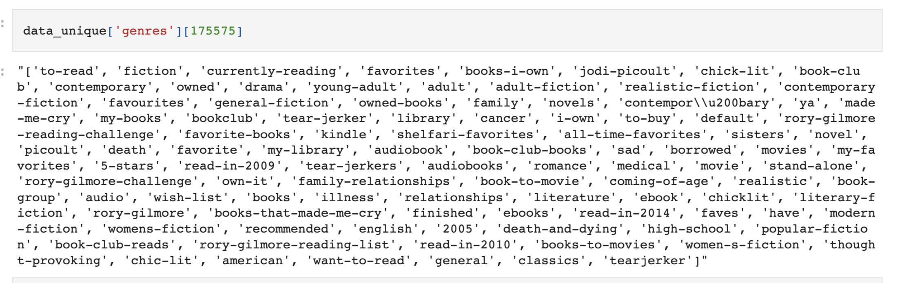
Cleaning the Genres Column
Problem Identification
Data Wrangling
Exploratory Data Analysis
Pre-Processing and Data Development
Modeling
Documentation
Remove space and make all text lowercase.
Stack the columns into a single column and count the frequencies
Notes:
#Remove space and make all text lower case.
# Split the genres column into multiple columns
Objective

Slide 16
Cleaning the Genres Column
Problem Identification
Data Wrangling
Exploratory Data Analysis
Pre-Processing and Data Development
Modeling
Documentation
Remove space and make all text lowercase.
Stack the columns into a single column and count the frequencies
Notes:
#Remove space and make all text lower case.
# Split the genres column into multiple columns
Eventually, I decided to drop the genres column
Objective based on user rating

Slide 17
Data After Cleaning
Problem Identification
Data Wrangling
Exploratory Data Analysis
Pre-Processing and Data Development
Modeling
Documentation
Columns | Number of Missing
book_id | 0
author_id | 0
authors | 0
title | 0
description | 0
publisher | 0
avg_ratings | 0
rating_count | 0
num_pages | 0
pub_year | 0
simillar_books | 0
Kind: CSV
Size: 53.2 MB
Shape (20000, 11)

Slide 18
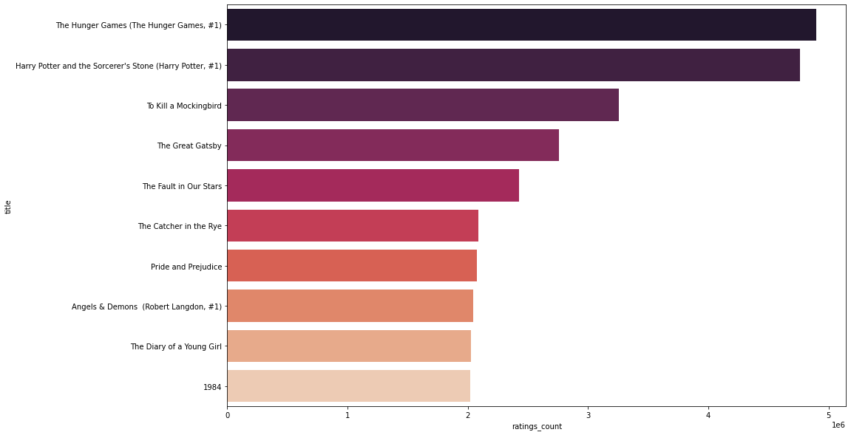
Problem Identification
Data Wrangling
Exploratory Data Analysis
Pre-Processing and Data Development
Modeling
Documentation
Most Rated Books

Slide 19
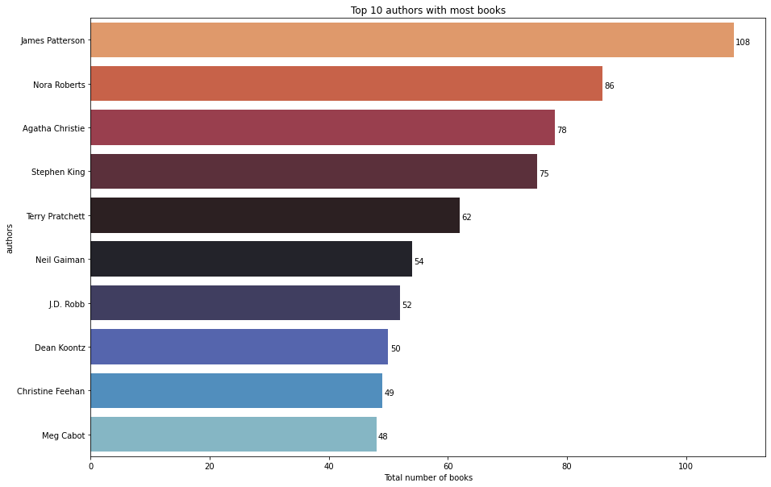
Problem Identification
Data Wrangling
Exploratory Data Analysis
Pre-Processing and Data Development
Modeling
Documentation
Authors with Most Books

Slide 20
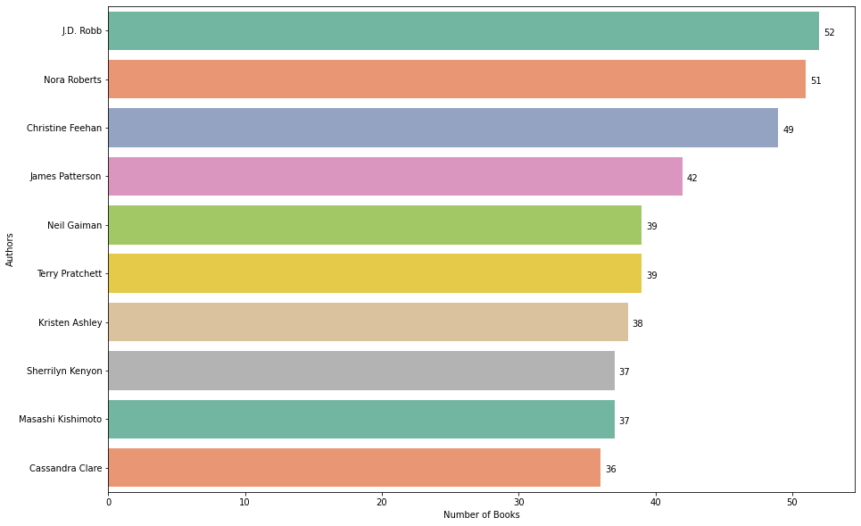
Problem Identification
Data Wrangling
Exploratory Data Analysis
Pre-Processing and Data Development
Modeling
Documentation
Highly Rated Authors

Slide 21
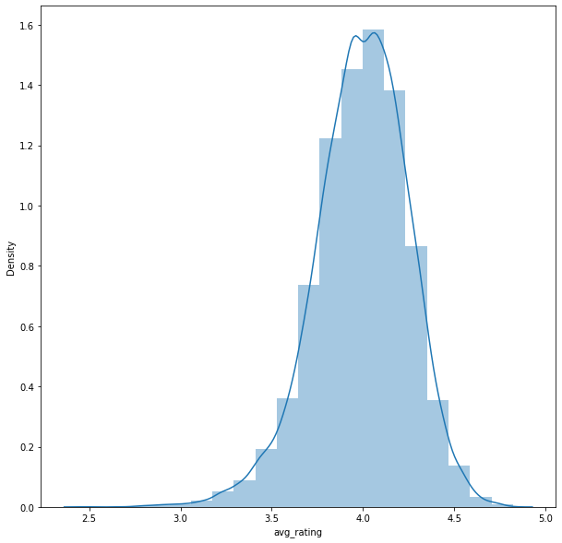
Problem Identification
Data Wrangling
Exploratory Data Analysis
Pre-Processing and Data Development
Modeling
Documentation
Average Rating Plot
Notes:
Normal distribution
Not Schewed , No outlier

Slide 22
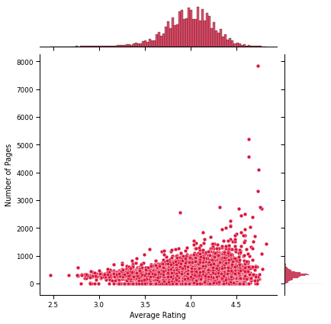
Problem Identification
Data Wrangling
Exploratory Data Analysis
Pre-Processing and Data Development
Modeling
Documentation
Correlation between Number of Pages and Ratings
Notes:
Number of page outlier

Slide 23
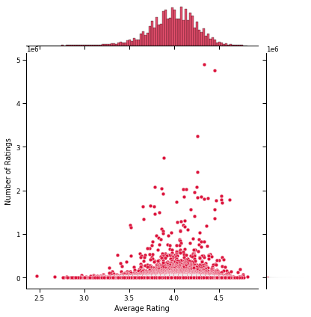
Problem Identification
Data Wrangling
Exploratory Data Analysis
Pre-Processing and Data Development
Modeling
Documentation
Correlation between Number of Ratings and Average Rating
Notes:
Positive Correlation

Slide 24
Using Natural Language Processing (NLP) to Cluster the Books Based on the Description

Slide 25
Problem Identification
Data Wrangling
Exploratory Data Analysis
Pre-Processing and Data Development
Modeling
Documentation
Step 1: Text Processing
Tokenization: The text in the description column must be parsed and transformed into a list of lowercase words.
Remove special characters and punctuation
Remove “stop words”: Commonly used words without any specific connotation (e.g., "the","a", "an", "in")
Remove extra space and short tokens
Use Natural Language Toolkit (NLTK) and Regular Expressions (RegEx) to clean up and tokenize our text.

Slide 26
Problem Identification
Data Wrangling
Exploratory Data Analysis
Pre-Processing and Data Development
Modeling
Documentation
Step 2: Word Embedding
Use Global Vectors for Word Representation (GloVe)
A word2vec model that is to say an unsupervised learning algorithm for obtaining vector representations for words. It allows you to take any corpus of text and transform each word into a position in high-dimensional space.
Download a pre-trained model that was trained on a broader corpus(Wikipedia)
Each line of the text file contains a word followed by N number. The N number describes the vector of the word position. N is varied depending on which model you choose to download.
Notes:
Use Global Vectors for Word Representation (GloVe): GloVe is a word2vec model that is to say an unsupervised learning algorithm for obtaining vector representations for words.It allows you to take any corpus of text and transform each word into a position in high-dimentional space.
Download a pretrained model that was trained on a broder corpus:Wikipidia Each line of text file contains a word follow by N number. The N number describe the vector of the word position. N is varid depending on which model you choose to download.

Slide 27
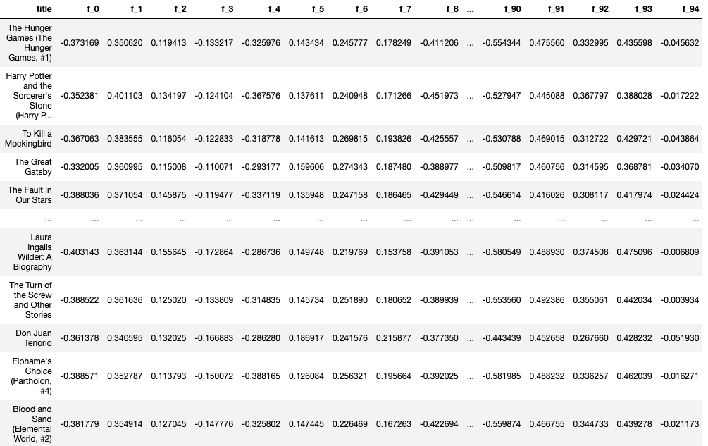
Problem Identification
Data Wrangling
Exploratory Data Analysis
Pre-Processing and Data Development
Modeling
Documentation
Step 2: Word Embedding
Generate embedded features for each book
Add features to a data frame
Define embedding column names (in the range of 100)
Notes:
Here is an example of a few titles with associated 100-dimensional vector

Slide 28
Problem Identification
Data Wrangling
Exploratory Data Analysis
Pre-Processing and Data Development
Modeling
Documentation
Step 3: KMeans Clustering
Using the distance between each book to find out which books are similar to each other
Notes:
Now that we have represented each book by a point in a multidimentional space, we can use an unsupervised ML model based on the distance between each books to find out which books are similar to each other.

Slide 29
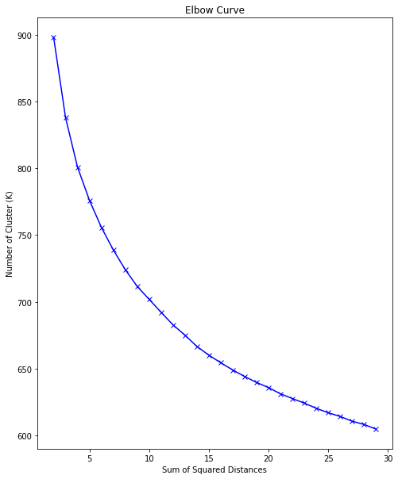
Problem Identification
Data Wrangling
Exploratory Data Analysis
Pre-Processing and Data Development
Modeling
Documentation
Step 3: KMeans Clustering (Choosing K using Elbow Method)
Notes:
The first step is to choose K
We notice that there is no discernable elbow to pick k

Slide 30
Problem Identification
Data Wrangling
Exploratory Data Analysis
Pre-Processing and Data Development
Modeling
Documentation
Step 3: KMeans Clustering (Choosing K using Gap Statistics)
Find the optimal K using the gap statistic
Builds on the sum-of-squares established in the Elbow method, and compares it to the sum-of-squares of a "null distribution," that is, a random set of points with no clustering
Notes:
The computation for the gap statistic builds on the sum-of-squares established in the Elbow method discussion, and compares it to the sum-of-squares of a "null distribution," that is, a random set of points with no clustering.

Slide 31
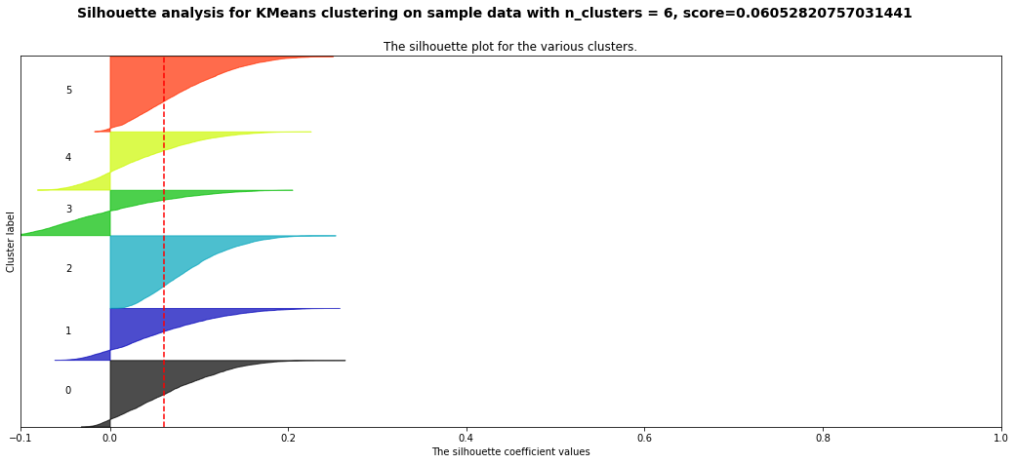
Problem Identification
Data Wrangling
Exploratory Data Analysis
Pre-Processing and Data Development
Modeling
Documentation
Step 3: KMeans Clustering (Choosing K using Silhouette Method)
# of Cluster | The average silhouette_score
2 | 0.1229486
3 | 0.09675944
4 | 0.07872317
5 | 0.06488438
6 | 0.060528208
7 | 0.05305962
8 | 0.051149532
9 | 0.05223356
10 | 0.04621785
11 | 0.047551572
Notes:
Now that we have represented each book by a point in a multidimentional space, we can use the distance between each books to find out which books are similar to each other.
KMeans Clustering (Choosing K using Gap Statistics) 10

Slide 32
Problem Identification
Data Wrangling
Exploratory Data Analysis
Pre-Processing and Data Development
Modeling
Documentation
Step 3: KMeans Clustering (Choosing K using Silhouette Method)
# of Cluster | The average silhouette_score
2 | 0.1229486
3 | 0.09675944
4 | 0.07872317
5 | 0.06488438
6 | 0.060528208
7 | 0.05305962
8 | 0.051149532
9 | 0.05223356
10 | 0.04621785
11 | 0.047551572
Notes:
Now that we have represented each book by a point in a multidimentional space, we can use the distance between each books to find out which books are similar to each other.
KMeans Clustering (Choosing K using Gap Statistics) 10

Slide 33
Problem Identification
Data Wrangling
Exploratory Data Analysis
Pre-Processing and Data Development
Modeling
Documentation
Step 4: KMeans (Cluster Profiling)
Using Cluster Analysis: The similar books will be grouped together.
Setting the number of group to 6
We use the KMeans clustering algorithm in the form of MiniBatchKmeans
Examine the most representative book from each cluster to see if the clustering work effectively.

Slide 34
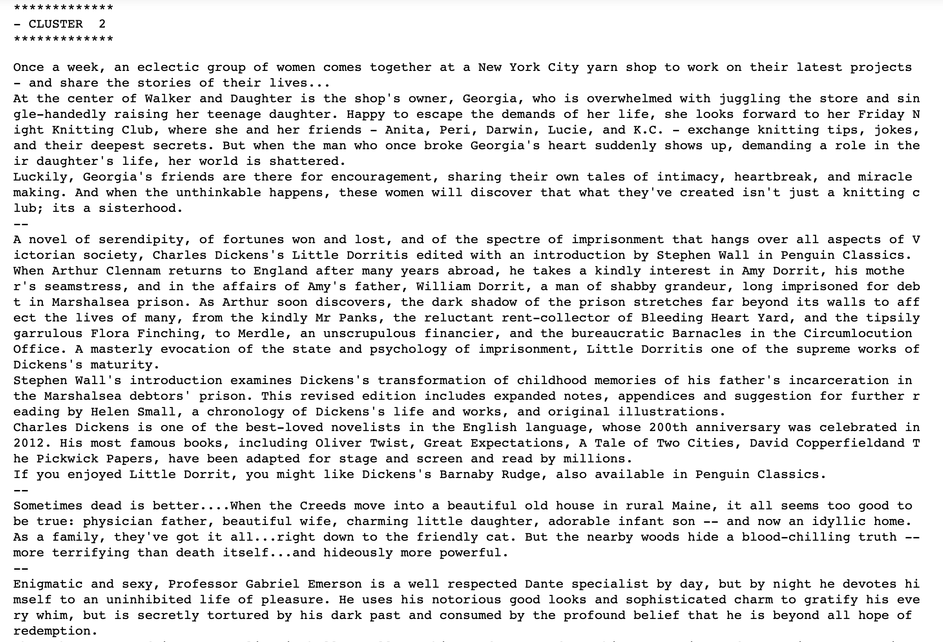
Problem Identification
Data Wrangling
Exploratory Data Analysis
Pre-Processing and Data Development
Modeling
Documentation
Step 4: KMeans (Examine the most representative book from each cluster)
Notes:
Examine the most representative book from each cluster to see if the clustering work effectively

Slide 35
Problem Identification
Data Wrangling
Exploratory Data Analysis
Pre-Processing and Data Development
Modeling
Documentation
Step 5: Dimensionality Reduction
(Reducing Variables using PCA)
To visualize high-dimensional datasets we used techniques of dimensionality reduction.
We will first reduce our dimensions from 100 to 50 using PCA
Using t-sne to visualize our clusters in 2 dimensions
Notes:
PCA is a technique for reducing the number of dimensions in a dataset while retaining most information. It analyzes the correlation between dimensions and attempts to provide a minimum number of variables that keeps the maximum amount of variation or information about the original data distribution.
we will first reduce our dimensions from 100 to 50 using PCA, and eventually using t-sne to visualize our clusters in 2 dimensions.

Slide 36
Problem Identification
Data Wrangling
Exploratory Data Analysis
Pre-Processing and Data Development
Modeling
Documentation
Step 5: Dimensionality Reduction (Execute TSNE Model)
t-Distributed Stochastic Neighbor Embedding (t-SNE) is a technique for dimensionality reduction that allows mapping a high-dimensional distribution to a 2-dim plane.
Notes:
Since this is computationally quite heavy, another dimensionality reduction technique is used in conjunction with it, e.g. Principal Component Analysis or PCA.

Slide 37
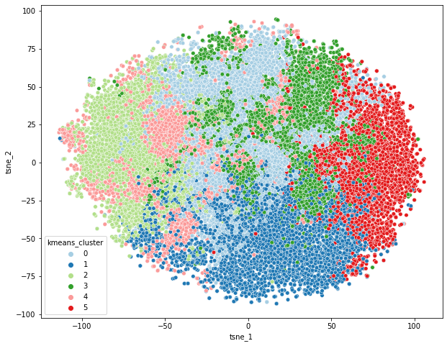
Problem Identification
Data Wrangling
Exploratory Data Analysis
Pre-Processing and Data Development
Modeling
Documentation
Step 5: Cluster Visualization

Slide 38
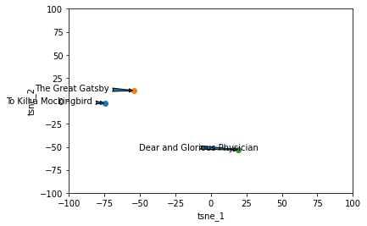
Problem Identification
Data Wrangling
Exploratory Data Analysis
Pre-Processing and Data Development
Modeling
Documentation
Sample Titles
Notes:
Samples of books dealing with different themes were assigned to different clusters and lay far from each other in the plot and sample of similar books are in similar clusters.
Novel/ fiction
Biography

Slide 39
Data Wrangling
Exploratory Data Analysis
Pre-Processing and Data Development
Documentation
Modeling
Problem Identification
Building Goodreads Book Recommendation Systems

Slide 40
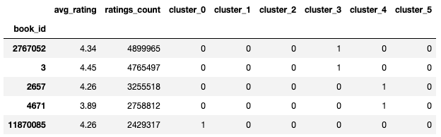
Problem Identification
Data Wrangling
Exploratory Data Analysis
Pre-Processing and Data Development
Modeling
Documentation
One-hot Encode Clusters
Notes:
No Code

Slide 41
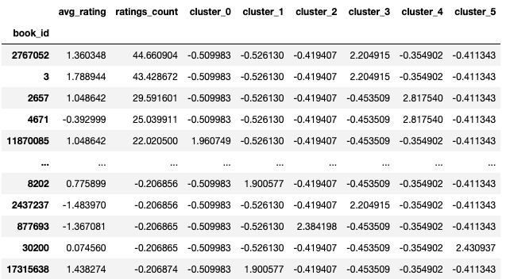
Problem Identification
Data Wrangling
Exploratory Data Analysis
Pre-Processing and Data Development
Modeling
Documentation
Recommendation Engine: Normalizing the Features
Normalize the features to have zero mean and unit variance
Notes:
features_norm = (features - features.mean())/ features.std()

Slide 42
Problem Identification
Data Wrangling
Exploratory Data Analysis
Pre-Processing and Data Development
Modeling
Documentation
Recommendation Engine Using Euclidean Distance Matrix
Calculate the Euclidean distance matrix between all pairs of books
Choose a target book ID
Get the row index for the target book in the cosine similarity matrix
Get the cosine similarity scores for the target book
Sort the scores in descending order
Get the top 10 most similar books (excluding the target book)
Print the top similar books
Order | Similar title to “The Fault in Our Stars” using Euclidean Distance Matrix
1 | The Diary of a Young Girl
2 | Pride and Prejudice
3 | The Catcher in the Rye
4 | The Great Gatsby
5 | Catching Fire (The Hunger Games, #2)
6 | 1984
7 | The Kite Runner
8 | Angels & Demons (Robert Langdon, #1)
9 | Harry Potter and the Chamber of Secrets (Harry Potter, #2)
10 | Divergent (Divergent, #1)
Notes:
Great Fiction / novel books

Slide 43
Problem Identification
Data Wrangling
Exploratory Data Analysis
Pre-Processing and Data Development
Modeling
Documentation
Recommendation Engine Using Cosine Similarity
Order | Similar title to “The Fault in Our Stars” Using Cosine Similarity
1 | The Diary of a Young Girl
2 | The Kite Runner
3 | Catching Fire (The Hunger Games, #2)
4 | Harry Potter and the Chamber of Secrets (Harry Potter, #2)
5 | Harry Potter and the Goblet of Fire (Harry Potter, #4)
6 | Of Mice and Men
7 | Charlotte's Web
8 | The Da Vinci Code (Robert Langdon, #2)
9 | Harry Potter and the Sorcerer's Stone (Harry Potter, #1)
10 | The Hunger Games (The Hunger Games, #1)
Calculate cosine similarity matrix
Choose a target book ID
Get the row index for the target book in the cosine similarity matrix
Get the cosine similarity scores for the target book
Sort the scores in descending order
Get the top 10 most similar books (excluding the target book)
Print the top similar books

Slide 44
Problem Identification
Data Wrangling
Exploratory Data Analysis
Pre-Processing and Data Development
Modeling
Documentation
Recommendation Engine Using Manhattan Distance
Order | Similar title to “The Fault in Our Stars” Using Manhattan Distance
1 | The Diary of a Young Girl
2 | The Kite Runner
3 | Catching Fire (The Hunger Games, #2)
4 | Harry Potter and the Chamber of Secrets (Harry Potter, #2)
5 | Harry Potter and the Goblet of Fire (Harry Potter, #4)
6 | Pride and Prejudice
7 | 1984
8 | Divergent (Divergent, #1)
9 | The Catcher in the Rye
10 | The Great Gatsby
Compute pairwise Manhattan distances between books in the same cluster
Choose a target book ID
Get the row index for the target book in the cosine similarity matrix
Get the cosine similarity scores for the target book
Sort the scores in descending order
Get the top 10 most similar books (excluding the target book)
Print the top similar books

Slide 45
Problem Identification
Data Wrangling
Exploratory Data Analysis
Pre-Processing and Data Development
Modeling
Documentation
Recommendation Engine Using K Nearest Neighbors
Order | Similar title to “The Fault in Our Stars” Using K Nearest Neighbors
1 | The Diary of a Young Girl
2 | Pride and Prejudice
3 | The Catcher in the Rye
4 | The Great Gatsby
5 | Catching Fire (The Hunger Games, #2)
6 | 1984
7 | The Kite Runner
8 | Angels & Demons (Robert Langdon, #1)
9 | Harry Potter and the Chamber of Secrets (Harry Potter, #2)
10 | Divergent (Divergent, #1)
Instantiate the KNN model
Fit the KNN model on the normalized features
Construct the pairwise distance matrix
Get the top 10 most similar books
Get the titles of the similar books

Slide 46
Problem Identification
Data Wrangling
Exploratory Data Analysis
Pre-Processing and Data Development
Modeling
Documentation
Documentation and Next Step
Provided on GitHub in a README file
Next Step:
Run the code on a cloud platform using the original data set
Model deployment

Slide 47




https://github.com/MaryamNzr
https://www.linkedin.com/in/maryam-nozariphd/
maryamnozariphd@gmail.com

